Slide 1

14
Monkeypox Prediction
TEAM :
2103A52137 G. Sri Harshini
2103A52147 K. Ajay Rao
2103A52159 Md. Naveed Sharief
Mentor and Trainer :
Mr. D. Ramesh
Assistant Professor
CS and AI&ML

Slide 2
Table of contents
01
Introduction
04
Image to NumPy Array
02
Problem Statement
05
Methodology
03
Dataset
06
Conclusion

Slide 3
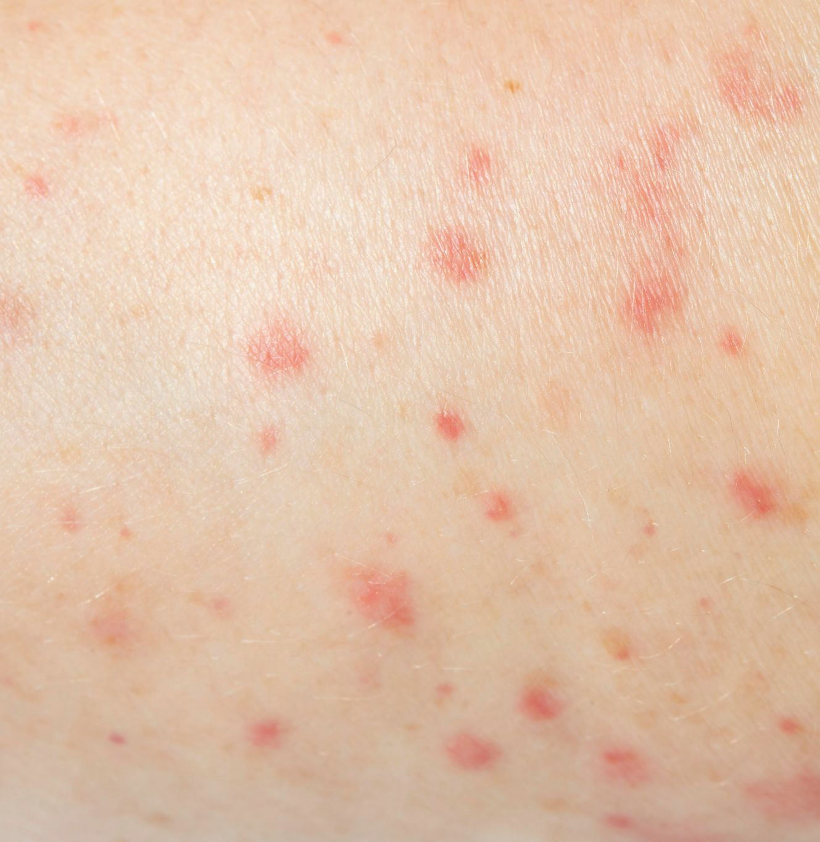
Introduction
Monkeypox is a zoonotic disease that was first discovered in monkeys in 1958.
The virus is similar to the one that causes smallpox, and it can cause a range of symptoms in humans, including fever, headache, muscle aches, and a rash. In severe cases, monkeypox can be fatal.
The disease is most commonly found in Central and West Africa, but it has also been reported in other parts of the world.

Slide 4
Problem Statement
PCR tests, which detect the presence of the monkeypox virus in a patient's blood or skin lesion samples, can usually provide results within a few hours to a day.
Serological tests, which detect antibodies to the virus in a patient's blood, can take longer to provide results, typically between one to two weeks.
The recent monkeypox outbreak has become a global healthcare concern owing to its rapid spread in more than 65 countries around the globe. To obstruct its expeditious pace, early diagnosis is a must. But the PCR tests and other biochemical assays are not readily available in sufficient quantities. In this scenario, computer-aided monkeypox identification from skin lesion images can be a beneficial measure.
By analyzing images of rashes and lesions, machine learning algorithms can identify patterns and features that are characteristic of the disease. This can help to speed up the diagnostic process and improve the accuracy of diagnoses.

Slide 5
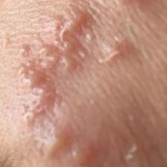
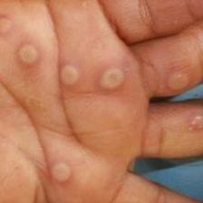
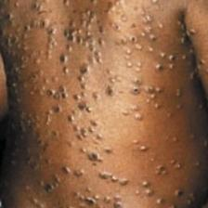
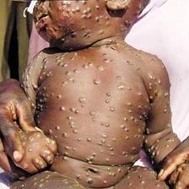
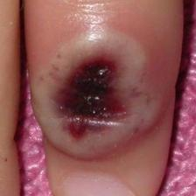
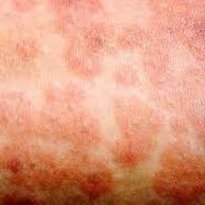
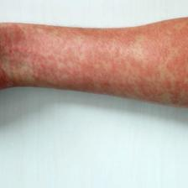
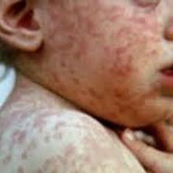
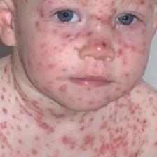
Dataset
It contains a total number of 228 images, among which 102 belongs to the 'Monkeypox' class and the remaining 126 represents the 'Others' class i.e., non-monkeypox (chickenpox and measles) cases.
Monkey Pox
Others
DATASET

Slide 6
Converting Image into NumPyArray
from google.colab import drive
drive.mount('/content/drive’)
import os
import cv2
import numpy as np
monkeypox_folder = '/content/drive/MyDrive/mpox/Original Images/Original Images/Monkey Pox'
non_monkeypox_folder = '/content/drive/MyDrive/mpox/Original Images/Original Images/Others' image_size = (224, 224)

Slide 7
Converting Image into NumPyArray
monkeypox_images = []
for filename in os.listdir(monkeypox_folder):
img = cv2.imread(os.path.join(monkeypox_folder, filename))
if img is not None:
img_gray = cv2.cvtColor(img, cv2.COLOR_BGR2GRAY) img_resized = cv2.resize(img, image_size) monkeypox_images.append(img_resized)
non_monkeypox_images = []
for filename in os.listdir(non_monkeypox_folder):
img = cv2.imread(os.path.join(non_monkeypox_folder, filename))
if img is not None:
img_gray = cv2.cvtColor(img, cv2.COLOR_BGR2GRAY)
img_resized = cv2.resize(img, image_size)
non_monkeypox_images.append(img_resized)

Slide 8
Converting Image into NumPyArray
monkeypox_images = np.array(monkeypox_images)
non_monkeypox_images = np.array(non_monkeypox_images)
print(type(monkeypox_images))
print(X)
print(y)

Slide 9
Converting Image into NumPy Array
[[116 161 218]
[116 161 218]
[115 160 217]
...
[109 161 207]
[110 162 208]
[112 164 210]]]]
[1. 1. 1. 1. 1. 1. 1. 1. 1. 1. 1. 1. 1. 1. 1. 1. 1. 1. 1. 1. 1. 1. 1. 1.
1. 1. 1. 1. 1. 1. 1. 1. 1. 1. 1. 1. 1. 1. 1. 1. 1. 1. 1. 1. 1. 1. 1. 1.
1. 1. 1. 1. 1. 1. 1. 1. 1. 1. 1. 1. 1. 1. 1. 1. 1. 1. 1. 1. 1. 1. 1. 1.
1. 1. 1. 1. 1. 1. 1. 1. 1. 1. 1. 1. 1. 1. 1. 1. 1. 1. 1. 1. 1. 1. 1. 1.
1. 1. 1. 1. 1. 1. 0. 0. 0. 0. 0. 0. 0. 0. 0. 0. 0. 0. 0. 0. 0. 0. 0. 0.
0. 0. 0. 0. 0. 0. 0. 0. 0. 0. 0. 0. 0. 0. 0. 0. 0. 0. 0. 0. 0. 0. 0. 0.
0. 0. 0. 0. 0. 0. 0. 0. 0. 0. 0. 0. 0. 0. 0. 0. 0. 0. 0. 0. 0. 0. 0. 0.
0. 0. 0. 0. 0. 0. 0. 0. 0. 0. 0. 0. 0. 0. 0. 0. 0. 0. 0. 0. 0. 0. 0. 0.
0. 0. 0. 0. 0. 0. 0. 0. 0. 0. 0. 0. 0. 0. 0. 0. 0. 0. 0. 0. 0. 0. 0. 0.
0. 0. 0. 0. 0. 0. 0. 0. 0. 0. 0. 0.]

Slide 10
Methodology
Since it is a qualitative data, we need to classify it and find the result value(1 or 0) 1 for Monkeypox 0 for Non monkeypox.
Under the types of Supervised Machine Learning, classification machine learning is used, in which different models like:
K-Nearest Neighbours(K-NN),
Logistic Regression
Support vector machine(SVM) and
Decision tree
These classification algorithms are to classify the data and detect the monkey pox.

Slide 11
Conclusion
In conclusion, the use of machine learning in monkeypox diagnosis and management shows great promise in improving the accuracy and speed of diagnoses and predicting outbreaks. However, the quality of data used in training is crucial, and machine learning should not replace clinical judgement. Continued research and development in this field has the potential to improve patient outcomes and contribute to global efforts to control infectious diseases.

Slide 12
THANK YOU

